Slide 1



IEEE Power & Energy Society
Presenter:- Simran Choudhary
Date:- 12/06/2020

Slide 2




The World’s Largest Professional Association Advancing Technology for Humanity
Global Reach
Technical Breadth
Social Impact
422,000+ Members
160+ Countries
123,000 Student Members
1,960+ Annual Conferences
4.5M+ Technical Documents
200+ Top-Cited Periodicals
1,300+ Active Standards
49 Technical Societies
Public Policy Engagement
Global Humanitarian Efforts
Education & Certification
Ethics in Technology

Slide 3


PES is the Second Largest Technical Society in the IEEE
37 other
Technical Societies
Membership & Image
Technical Activities
New
Initiatives
Chapters
Publications
Education
Meetings
Standards Development
Technical
Committees
Coordinating
Committees
Technical Council

Slide 4
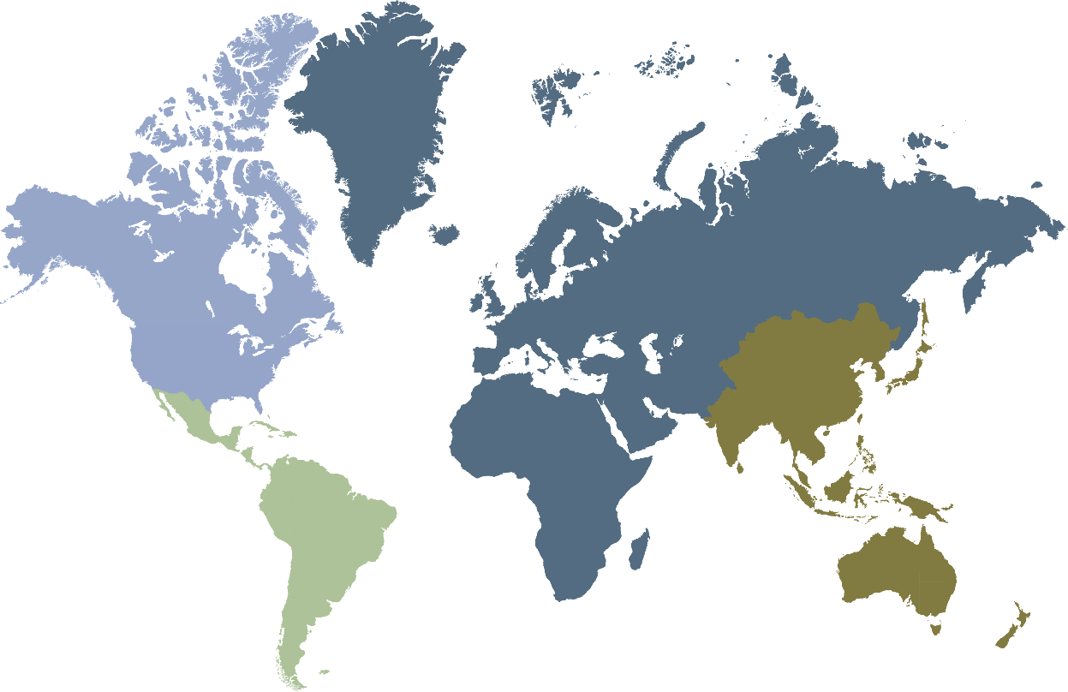
Global Engagement Through Local Chapters
Over 40,000 members in 150 countries
REGION 1-7
128 chapters | 68 student chapters | 19,835 members
REGION 8
48 chapters | 78 student chapters | 5,803 members
REGION 9
36 chapters | 114 student chapters | 3,119 members
REGION 10
46 chapters | 179 student chapters | 11,185 members
258 Chapters and 439 Student Chapters: PES Chapters are a great way to plug in to the society in most parts of the world and get involved.
>50% of members are outside USA

Slide 5
By actively engaging in PES, you can stay up to date on the latest industry advances
Boost self engagement by providing yourself with:
Latest information about current trends and all aspects of the fast-changing industry
Industry insight through Power & Energy and Electrification magazines, technical reports and peer-reviewed journals
Compelling programs and peer engagement at our conferences and events
Platforms to tackle challenges via IEEE standards-development and technical committees
Opportunities to meet and collaborate via our local chapters and the global PES community
Get Involved. Email: pes@ieee.org

Slide 6
PES Technical Community
Analytic Methods for Power Systems
Electric Machinery
Energy Development and Power Generation
Energy Storage and Stationary Battery
Insulated Conductors
Nuclear Power Engineering
Power System Communications and Cybersecurity
Power System Dynamic Performance
Power System Instrumentation and Measurements
Power System Operations, Planning and Economics
Power System Planning and Implementation
Power System Relaying and Control
Smart Buildings, Loads and Customer Systems
Substations Committee
Surge Protective Devices
Switchgear
Transformers
Transmission and Distribution
Coordinating Committees:
Intelligent Grid & Emerging Technologies
Marine Systems
Wind and Solar Power

Slide 7
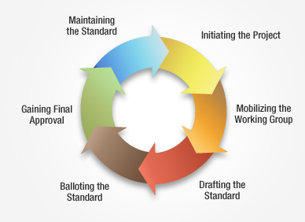
IEEE Standards Development Lifecycle
IEEE Standards are developed using a time-tested, effective and trusted process that is easily explained in a six stage lifecycle diagram
45%+ IEEE Standards are Created by PES Technical Committees
Get Involved. Visit: standards.ieee.org/getinvolved

Slide 8
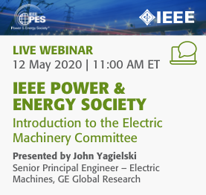
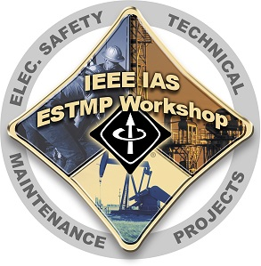
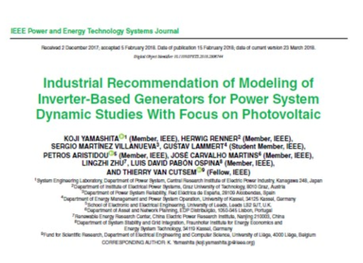
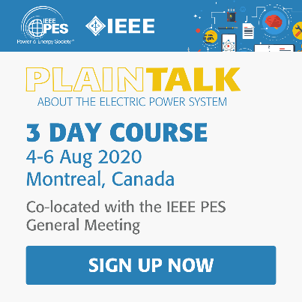
Stay Technically Proficient with PES
PES is deploying significant resources for training and lifelong learning activities for our practicing engineer members.
Online Webinars
& Tutorials
On-site Training & Workshops
Practice-Oriented Technical Journal
Plain Talk Basic Courses for Industry Novice

Slide 9
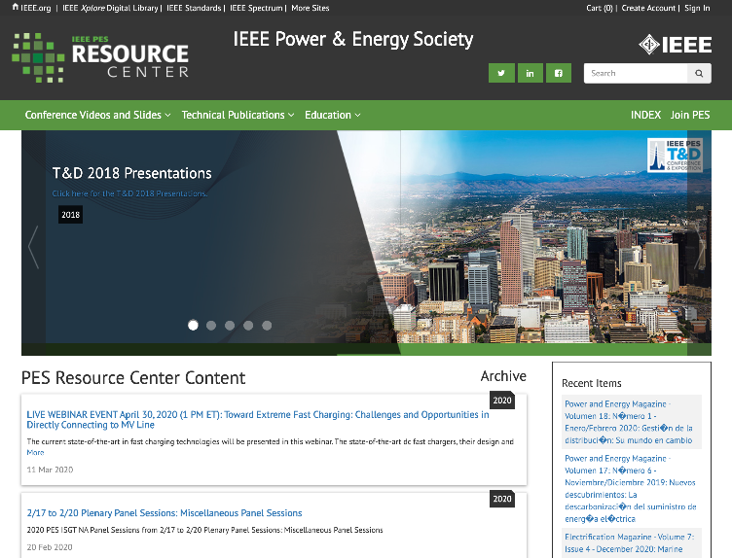

Everything You Need IN ONE PLACE
Visit the IEEE PES Resource Center
The IEEE PES Resource Center is the most extensive library in the world devoted exclusively to the power and energy industry. You don’t have to be a PES member to access the Resource Center’s vast array of industry oriented content, which is available to assist in your research, presentations, or academic programs, and benefit your professional development!
resourcecenter.ieee.pes.org
PES MEMBER ACCESS
Most materials in the PES Resource Center are free to society members – an important member benefit.
.
Earn Continuing Education Credits
Register for live educational events
Watch Video Tutorials & Archived Webinars
Update Your License with CEU/PDH credits
Download Full PES Magazines
Access Conference Videos & Presentations
Download Complete Technical Reports

Slide 10
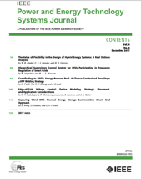
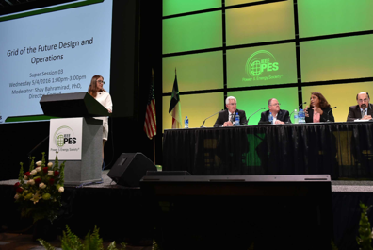
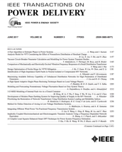
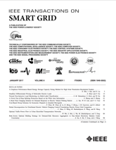
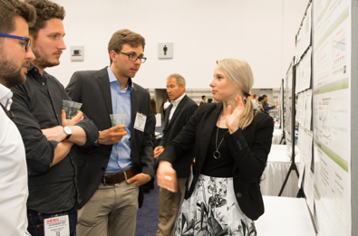
Engaging Academic Community
Publishing Research
Sharing Ideas with Peers
Posters Presentations
Standards Development

Slide 11
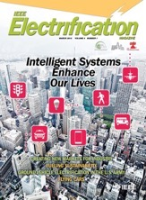
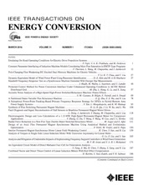


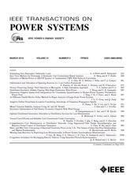
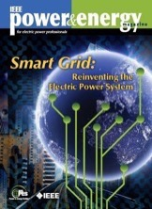
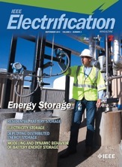

Publications
Two award-winning magazines, Power & Energy and Electrification
Spanish P&E Magazine, Transactions, and an open-access journal (OAJPE)
Latest PES updates shared in monthly eNews, bi-weekly PES eBulletin and other email announcements
New – IEEE Open Access Journal of Power & Energy

Slide 12
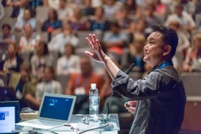

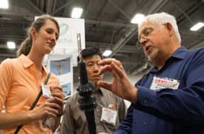

IEEE PES Membership Diversity
Diverse Technical Backgrounds
Utilities, Municipalities and RTOs/ISOs
Academics and Research
Equipment Manufacturers and System Suppliers
Government and Regulatory
Testing Labs, Consulting and more
Attracting wide audiences by creating and implementing new technical ideas and applying best practices through output and initiatives

Slide 13

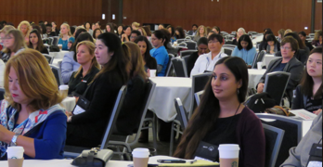
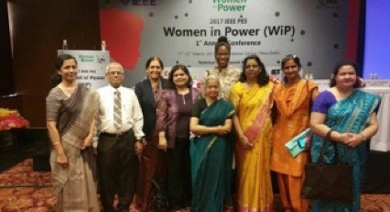

Developing Women in Power
Fostering a more diverse leadership by supporting the career advancement, networking and education of women in the energy industry
Get Involved. Visit: pes-women-in-power.org

Slide 14
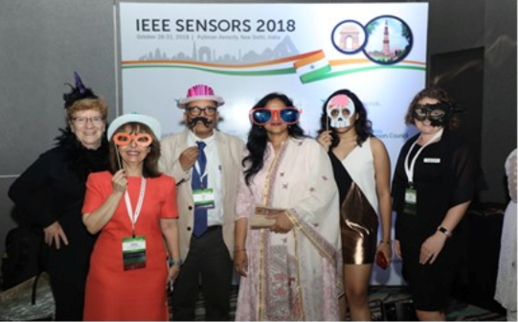
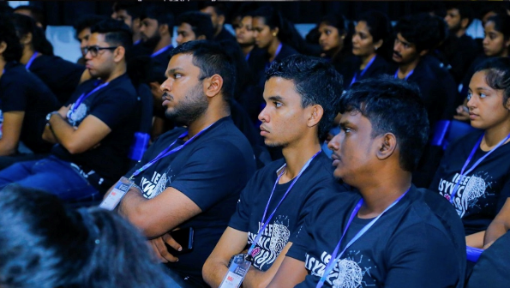
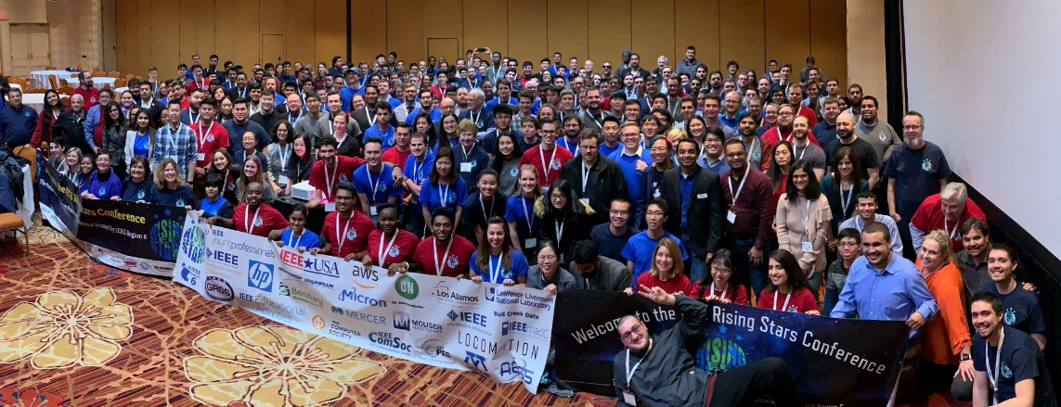
Mentoring Young Professionals
Over 6,200 PES Young Professionals worldwide, and growing!
Helping young professionals evaluate their career goals, polish their professional image, and create the building blocks of a lifelong and diverse professional network
Get Involved. Visit: sites.ieee.org/pes-yp

Slide 15




Collaborating to encourage the successful rollout of technologically advanced, environment-friendly and secure smart-grid networks around the world.
Set the Global Standard via Collaboration
Provide Education, Research and Innovation
Expand Global Reach via Marketing
Get Involved. Visit: smartgrid.ieee.org

Slide 16
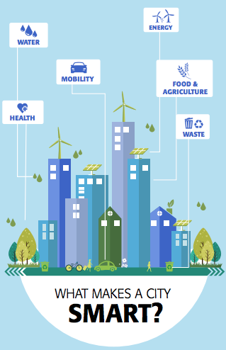
Brings together various IEEE’s technical societies and organizations to advance the state of the art for smart city technologies for the benefit of society
Serves as neutral broker of information amongst industry, academic, and government stakeholders.
Smart Buildings
Smart Living
Smart Transportation
Smart Energy
Smart Communications
Smart Networks
Self-Aware Digital Hub
Environmental Awareness
Get Involved. Visit: smartcities.ieee.org

Slide 17
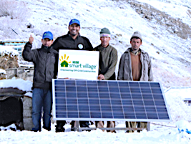
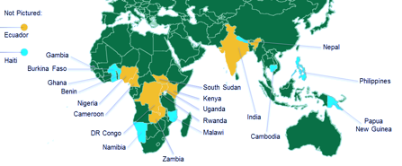
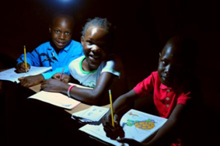
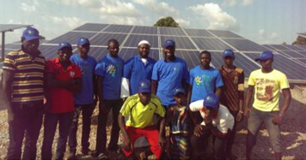
An institute-wide humanitarian program supported by PES
Signature program of the IEEE Foundation.
Dramatically bettering the lives of more than 100,000 off-grid villagers with light and modest power
Get Involved. Visit: ieee-smart-village.org

Slide 18
Thank you for your time and efforts.
For further details contact:-
Radnyi Jagtap : 9757028208
Simran Choudhary : 9867792087

